Slide 1

ONAP & OPNVF
David Wu
October, 2018
PROPRIETARY AND CONFIDENTIAL

Slide 2
Agenda
ONAP
OPNFV
Q & A?

Slide 3
ONAP

Slide 4
ONAP - What is ONAP
ONAP – Open Network Automation Platform
Open source software platform delivers capabilities for the design, creation, orchestration, monitoring, and life cycle management of
Virtual Network Functions (VNFs)
Carrier-scale Software Defined Networks (SDNs)
Higher-level services that combine the above
ONAP - project combining ECOMP and Open-O
Automatic, policy-driven interaction of these functions and services in a dynamic, real-time cloud environment

Slide 5
ONAP - Benefits
ONAP uses cloud technologies and network virtualization to offer services, achieving both faster development and greater operational automation
Enables service providers to quickly add features and reduces operations costs
More control of network services for service providers
Consumers benefit
Faster processes from ordering, design, testing and deployment of a new service
Network adapts and scales better

Slide 6
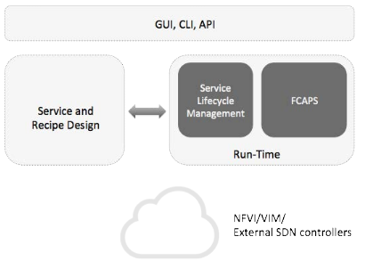
ONAP - Architecture
ONAP is a composition of several (10+) applications
ONAP is divided in 2 main functional areas: design & run-time

Slide 7
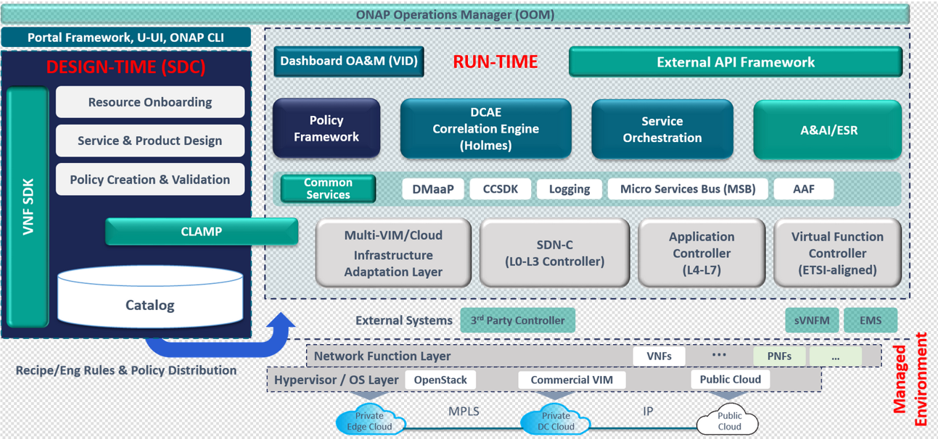
ONAP - Architecture

Slide 8
ONAP - Architecture Highlights
Architecture divided into two major components
Design Framework
Resource Onboarding
Service and Product Design
Policy Creation and Validation
Catalog
Runtime Framework
Virtual Function Controller (VNFM)
Application Controller (L4-L7)
SDN Controller (L0-L3)
Multi-VIM/Cloud Infrastructure Layer
Service Orchestration
Policy Framework
Data Collection, Analytics and Events (DCAE) Correlation Engine
Active and Available Inventory (A&AI)

Slide 9
ONAP - Design Framework
Design framework consists of following subsystems
Service Design and Creation (SDC)
Policy
SDC subsystem to define, simulate, and certify assets and their associated processes and policies
Policy subsystem enables creation and deployment of rules that instantiate conditions, requirements, constraints, attributes, or needs regarding assets that must be provisioned, maintained, or enforced

Slide 10
ONAP - Runtime Framework
Execution framework distributes and executes the rules and policies that are designed within design framework, and consists of the following subsystems:
Active and Available Inventory (AAI)
Controllers
Dashboard
Data Collection, Analytics and Events (DCAE)
Master Service Orchestrator (MSO)
Security Framework
All subsystems rely on Common Services to provide access control, logging, data management, and other support

Slide 11
ONAP - Control Loop
The core/main ONAP components involved in C.L. are: DCAE, CLAMP, Policy and SDC.
A Control Loop does several functions:
Collect data about VNFs or VNF infrastructure
Compute analytics based on collected data
For open loop, send message to ticketing system for human intervention
For closed loop, execute one of many actions to remediate the network condition
For closed loop, detect that a network condition has been corrected through our actions

Slide 12
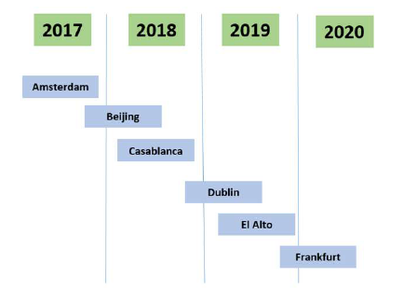
ONAP - Release Cycle
ONAP adapted a 6 month release cycle
Two releases per calendar year

Slide 13
ONAP - Installation
3 approaches to install ONAP:
Full ONAP installation using Heat template
Advanced installation to install individual components
Experimental installation using Kubernetes

Slide 14
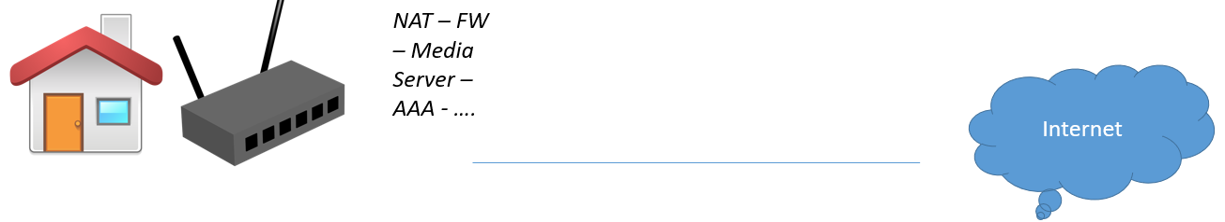

ONAP - Use Case – vCPE
From :
To

Slide 15
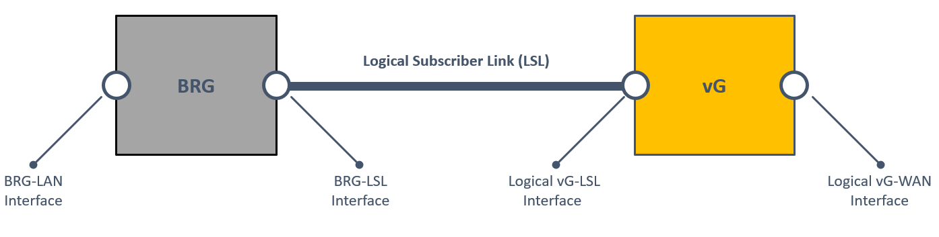
ONAP - Use Case – vCPE
Functions provided traditionally by RG are distributed between:
On-site device (Bridged Residential Gateway — BRG)
Cloud-based component (Virtual Gateway — vG)

Slide 16
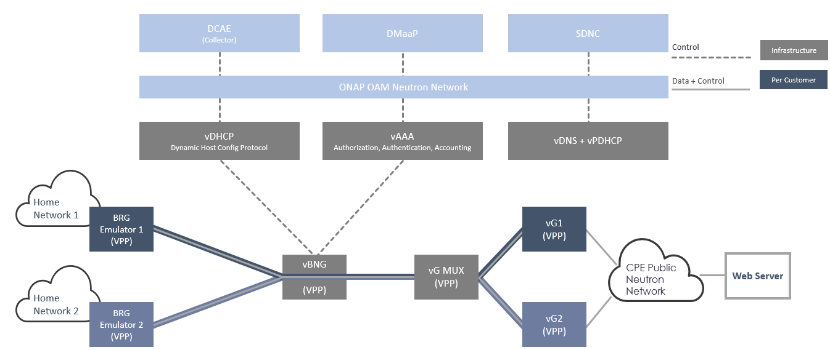
ONAP - Use Case – vCPE

Slide 17
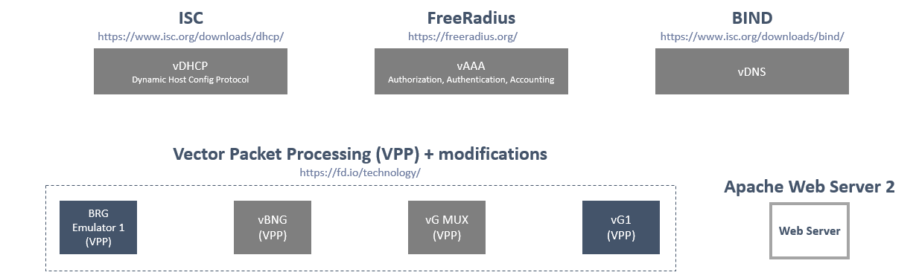
ONAP - Use Case – vCPE
All VNFs are open source, no physical components
HEAT templates produced for all VNFs

Slide 18
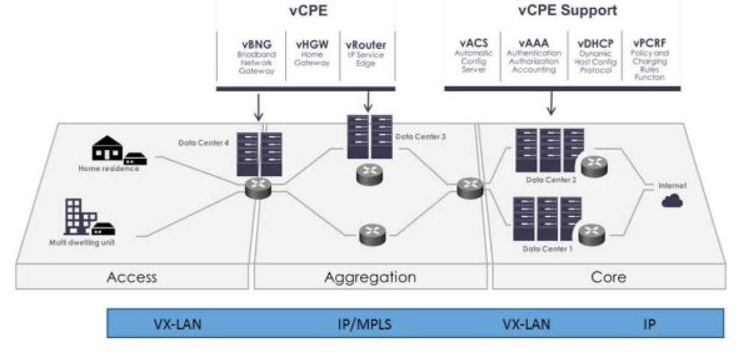
ONAP - Use Case – vCPE

Slide 19
ONAP - Use Case Design Time – Onboarding
Upload descriptive model of the virtual function (Heat, TOSCA)
Validate, assign, license, certify virtual function
Create catalog entry, assign data/metadata
Distribute for instantiation

Slide 20
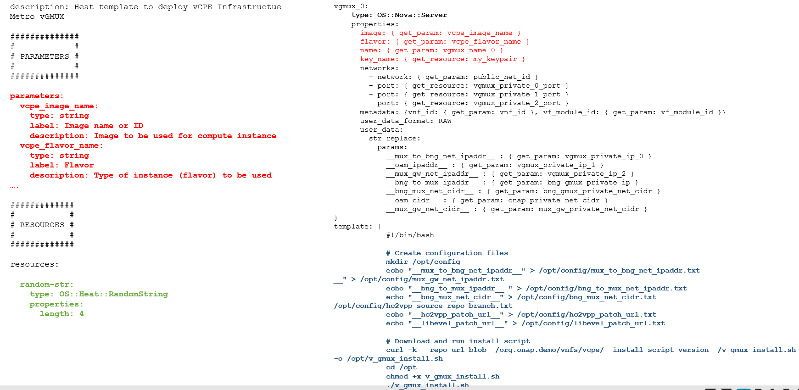
ONAP - Use Case Design Time – Onboarding – YAML

Slide 21
OPNFV

Slide 22
OPNFV - OPNFV Project Goals
Develop an integrated and tested open source platform that can be used to build NFV functionality, accelerating the introduction of new products and services
Include participation of leading end users to validate OPNFV meets the needs of user community
Contribute to and participate in relevant open source projects that will be leveraged in the OPNFV platform; ensure consistency, performance and interoperability among open source components
Establish an ecosystem for NFV solutions based on open standards and software
Promote OPNFV as the preferred open reference platform

Slide 23
OPNFV - Upstream Open Source
Work directly with upstream open source projects (OpenDaylight, OpenStack, KVM and Xen, and many others)
Work directly with standards bodies (ETSI and others)
Leverage existing codebases
Integrate existing open source components
Identify gaps to create new code
Provide a point of integration, testing and performance optimization

Slide 24
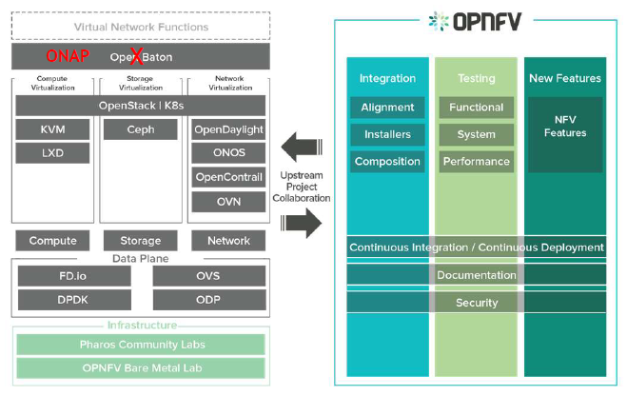
OPNFV - Overview

Slide 25
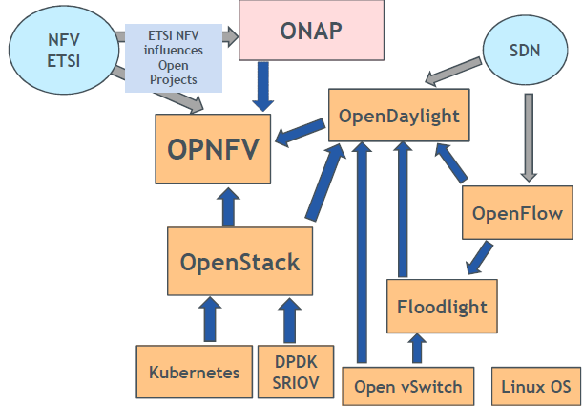
OPNFV
Projects included in OPNFV
ONAP
OpenStack
OpenDaylight
Open vSwitch
ONOS
OpenContrail
ETSI NFV ISG
IETF
DPDK
libvirt
QEMU/KVM
Linux kernel

Slide 26
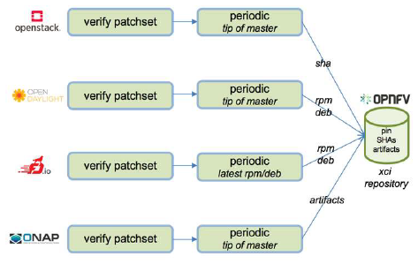
OPNFV
Cross Community Continuous Integration (XCI)
ONAP community is working to be plugged into the XCI environment
OPNFV develops, operates, and maintains its Continuous Integration (CI) process used by OPNFV community to develop, integrate, test and release the integrated reference platform for NFV
More Open Source communities adapt and plug into XCI

Slide 27
OPNFV
OPNFV Test Framework
Functest
Refactoring to add Kubernetes support in progress
Python Library Xtesting
Xtesting leverages Functest
Enables to build a CI/CD toolchain

Slide 28
Q & A?

